Slide 1
Git Tag
Tag is the name given to set of versions of files/directories.
It indicates milestone of the project, we can easily remember tags in future.
If I want good code in the future, we tag it by giving a proper name.

Slide 2
Tag
How to create a tag
Git tag tag-name
How to see the list of tags:
  Git Tag
How to move from one tag to another:
  Git checkout tag-name

Slide 3
To delete branch/tag
How to delete the Branch/Tag
git branch –d Branch_name
git tag –d Tag-name

Slide 4
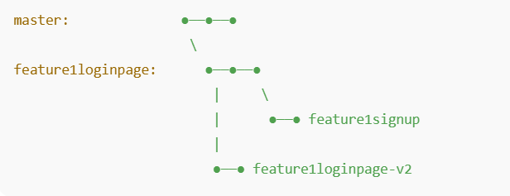
For the feature

Slide 5
Git Merge
  Is used to integrate two/more branches
git merge branch-Name
Git branch
* master
Br22 →br56
Git checkout br56
Git merge Br22
Git branch

Slide 6
Merging Conflicts
Merging conflicts will occur when the same piece of code is changed on 2 different branches.
when we try to merge those 2 branches then merging conflict will occur. To resolve this issue, I don’t know whose change should I take to merge.
So I contact developer who modified the code on Branch1 & Branch2.
Then they will decide and tell me whose changes should I take into merge.
Then I take that change and I Commit it.
I will get to know who modified the code on Branch 1 & Branch2 using git log command

Slide 7
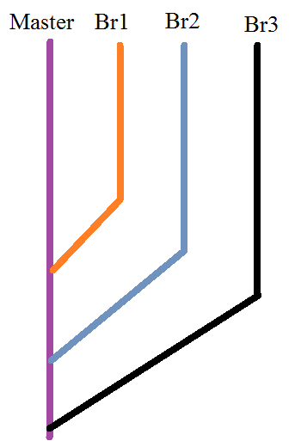

Slide 8
Git Pull
Bringing the changes form remote repo and merging to local repo automatically
Git pull GitHubUrl

Slide 9
Git Fetch
Bringing the changes from remote repo and stores it on separate branch, you can review the changes and merge normally if it is required.
Git fetch GitHubUrl
Git Merge BranchName
Git Pull = Git Fetch + Git Merge

Slide 10
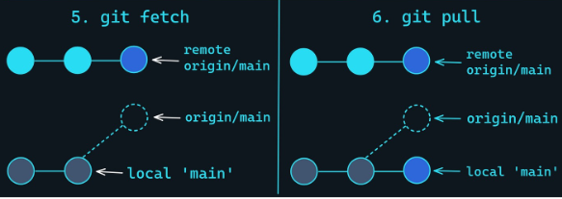

Slide 11
Git Push
Moving the changes from local Repository (workspace) to Central Repository (Remote repo)
Git push GitHubUrl
Git remote add origin GitHubUrl
Git Push –u Origin master

Slide 12
Feature / Behavior | git pull | git fetch
What it does | Downloads changes AND merges them into your current branch | Only downloads changes, does NOT merge automatically
Local working directory | ✔ Updated automatically | ❌ Not updated
Safety level | ⚠️ Less safe (auto-merge may cause conflicts) | ⭐ Very safe (no changes to working files)
Use case | When you want to update your branch immediately | When you want to review changes before merging
Command includes | git fetch + git merge | Only fetch (no merge)
Risk of breaking your code? | ⚠️ Yes, because merging happens automatically | ❌ No risk, fetch only downloads metadata
Common usage | Updating local branch with remote | Checking what is new on remote without touching your local code
Typical workflow | Pull → auto-merge happens | Fetch → manually merge or rebase later
Commands | git pull origin main | git fetch origin
Ideal for | Quick updates | Safe preview before integrating changes

Slide 13
Central Repo (GitHub)
1. Git CLone
2.Git
Push
3.Git
Pull
4.Git
Push
Local Machine/
System/
Local Repo

Slide 14
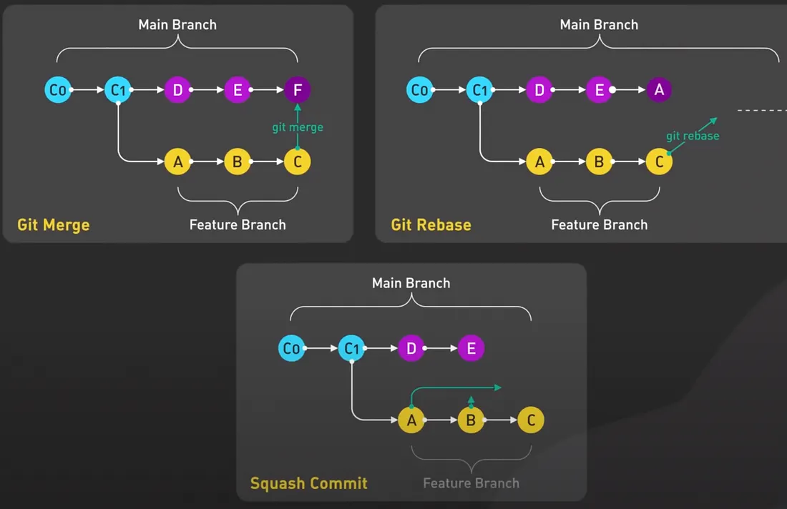

Slide 15
Feature / Behavior | Git Merge | Git Rebase | Squash Commit
What it does | Combines two branches with a merge commit | Moves feature commits on top of another branch | Combines all commits into ONE commit
History style | Non-linear (branching) | Linear (straight line) | Linear (single commit)
Rewrites history | ❌ No | ✔ Yes | ✔ Yes
Creates new commit | ✔ Yes (merge commit) | ✔ Yes (new rewritten commits) | ✔ Yes (one squashed commit)
Original commits preserved | ✔ Yes | ❌ No (they become new commits) | ❌ No (they are replaced by one commit)
Use case | Team merging, safe operations | Clean history before PR | Clean, single commit for PR
Risk level | ⭐ Safe | ⚠️ Risky (don’t use on shared branches) | ⭐ Safe
When to use | When preserving full history is important | When you want a clean, linear history | When feature branch has many small/WIP commits
Commit Graph Example | Includes merge bubble | Straightened history | One commit replaces all feature commits
Command | git merge feature | git rebase main | git merge --squash feature

Slide 16
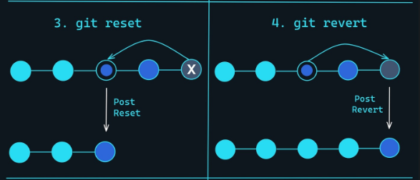

Slide 17
Feature / Behavior | Git Reset | Git Revert
What it does | Moves the branch pointer back to a previous commit (changes history) | Creates a NEW commit that undoes the changes of an old commit
History Impact | ❌ Rewrites history | ✔ Preserves history
Safe for shared branches? | ❌ No, dangerous on shared branches | ✔ Yes, safe for shared branches
Affects commit history? | ✔ Yes (removes commits) | ❌ No (adds a new inverse commit)
Working directory impact | Depends on mode (--soft, --mixed, --hard) | Does not modify uncommitted work
Undoing changes | Removes commits entirely | Reverses the effect of a commit with a new commit
Use case | Fix local mistakes before pushing | Undo a mistake that is already pushed to remote
Command | git reset --hard <commit> | git revert <commit>
Is it destructive? | ⚠️ Yes (especially --hard) | ❌ No
Keeps commit history clean? | ✔ Yes, but rewrites it | ✔ Yes, but adds a revert commit
Example outcome | Branch moves backwards | New commit: “Revert ”
Best used when | You haven’t pushed your changes yet | You have already pushed changes and want to safely undo them

